Slide 1
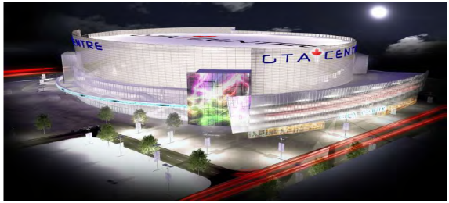
URA ARENA SUB COMMITTEE
PRESENTATION AGENDA
  SURVEY RESULTS
  FINANCIAL FRAMEWORK SUMMARY
  KEY ISSUES SUMMARY
  INFORMATION SOURCES UPDATED
  UPCOMING CITY MEETINGS
  NEXT STEPS?

Slide 2
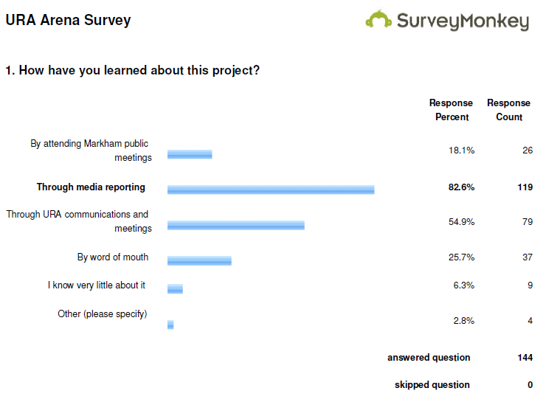

Slide 3
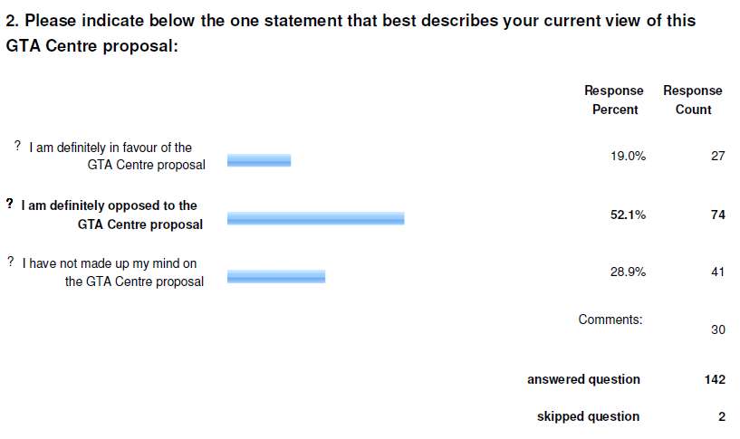

Slide 4
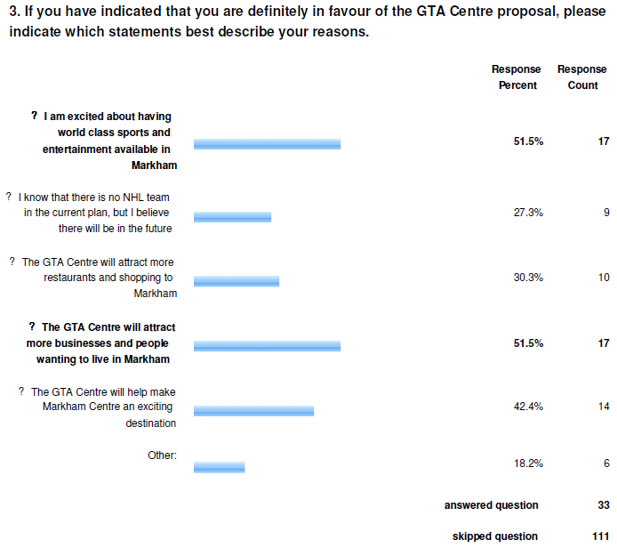

Slide 5
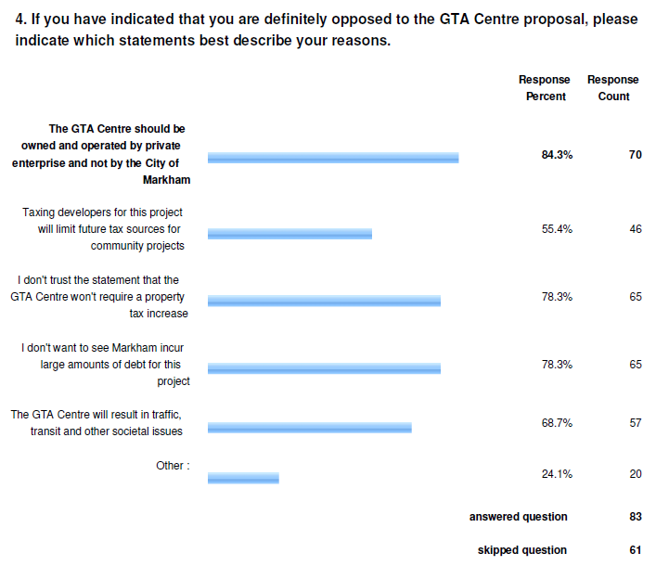

Slide 6
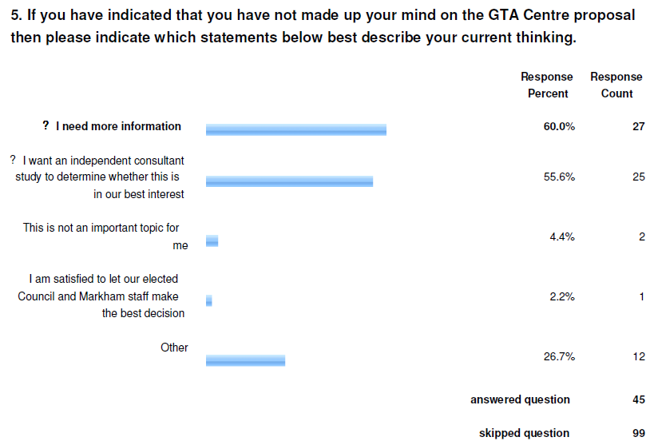

Slide 7

Financial Arrangement – Any More Questions?
Remington provides land to City to offset parkland commitments
City Of Markham
Owns 100% of Arena
Markham takes out a loan for $325 Million
GTA S&E
makes half the loan repayments
City Contracts with GTA S&E to build Arena for a fixed price
GTA S&E
Leases Arena from
City of Markham
Remington Group provides financial backing to GTA S&E
GTA S&E contracts with BBB Architecture &
PCL Construction to
Build Arena for fixed price
GTA Centre contracts
With Global Spectrum
& Live Nation to Operate
Arena
How is it all tied together
for full accountability?
Risks & Mitigation Plans?
Contract & Scope
Management?

Slide 8
Update on key questions – Summary
What happens, who pays, if GTA Sports LP declares bankruptcy?
  The Arena is not a commercial success.
  No NHL team, or we get an NHL team but then it moves.
A main revenue stream is a "voluntary" increase in development charges. Is it legal? What happens if they want their money back?
Can a privately operated MSECC qualify as an MCF?
Is Mr Roustan an appropriate partner?
Can the Arena be successful without an adequate multi-modal transit system? If parking can be built, can punters get to and from the events in a timely manner? Will this limit other opportunities to better develop those lands, which would then contribute to taxes?
Lack of transparency.
  DOU
  Outstanding requests for information.

Slide 9
MSECC Links To More Information
Markham City MSECC project information and Feedback button MSECC.
National Post article on the financial framework National Post Oct 5th.
Toronto Star overview of the whole project Toronto Star Oct 5th.
Toronto Star article on Graeme Roustan Toronto Star Oct 7th.
Toronto Star on viability of Arenas without an NHL team Star Oct 9th.
Toronto Star Editorial Oct 10th 2012 Toronto Star Editorial Oct 10th.
Settler's Park RA Artem Pozdniakov’s repository www.markhamarena.ca/
National Post October 13th interview with consulting economist Post

Slide 10
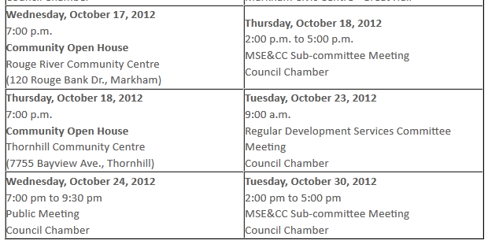
Upcoming City Meetings

Slide 11
That’s it Folks!
What if there is no more information?
What Next?

